Slide 1
Data Analytics
Pattern Discovery (Unsupervised learning)
Association Rule Mining
Clustering
Predictive Modeling
(Supervised Learning)
Regression (Predicting numeric outcome)
Classification
(Predicting categorical outcome)
Regression:
a continuous-valued prediction
Classification:
a discrete-valued prediction

Slide 2
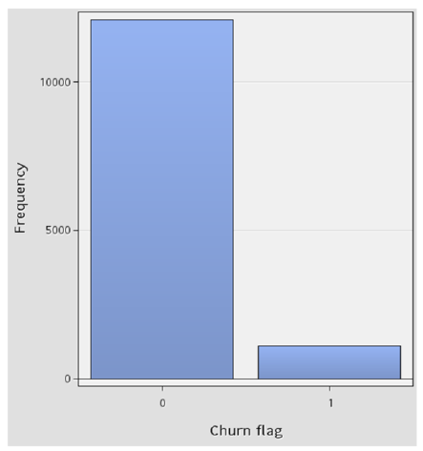
Not all target variables (Outcome) are continuous
There are many important business questions for which the target variable is not continuous.
For example:
Email Spam or not spam
Online transactions Fraud or not Fraud
Tumor Malignant or Benign
Student Pass or Fail
Customer Buy or not
Telco Subscriber Churn or not
etc

Slide 3
About Logistic Regression
Linear Regression is used to predict continuous outcome (e.g. test scores, housing prices)
Logistic Regression is used for the classification problems, it is a predictive analysis algorithm and based on the concept of probability.
When the dependent variable is binary-valued or dichotomous (e.g. have values 0 and 1), linear regression cannot be is used.
Example
Y, the dependent variable, whether a customer will response to a sale (0 = don’t respond, 1 = respond)
X, the independent variable, is the level of satisfaction with the store

Slide 4
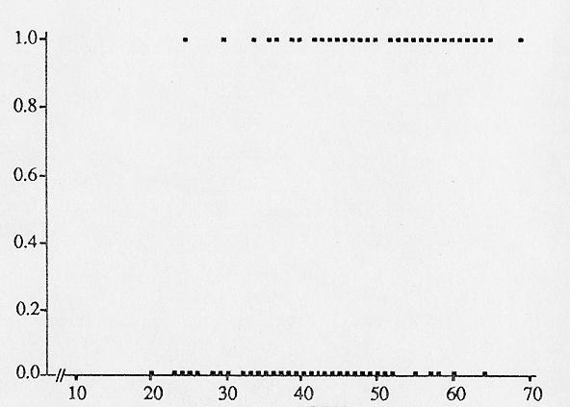
About Logistic Regression
Plotting X vs Y will give us a scatter diagram resembling the one shown below. Notice Y takes value of only 0 or 1.

Slide 5

Why not just use Linear Regression?
The ‘best-fit’ line found by Linear Regression will not make sense in this instance.

Slide 6
Why not just use Linear Regression?
For example, if X = 40, we get Y = 0.5 (approximately), which is neither 0 nor 1.
In the case of a binary target variable, the assumptions of linear regression are not valid!
Because:
• The relationship between the target variable and predictor variable is not linear.
• the error terms are not normally distributed.

Slide 7
About Logistic Regression
The strategy is to find a function that can be used to determine the probability that customer will respond to sale given his satisfaction score.
We use conditional probability of Y given X.
p = Prob (Y=1 | X)
In our case, it will be Prob (Respond | Satisfaction Score)
The use of probability suited our needs since probability ranges between 0 and 1.

Slide 8
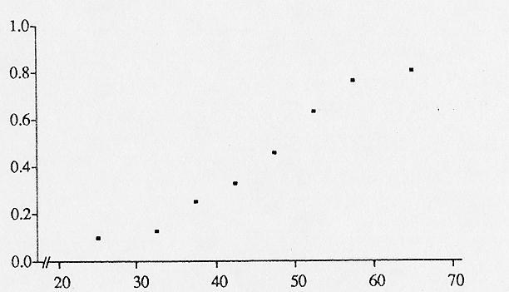
About Logistic Regression
Instead of plotting X vs Y, we plot X vs Prob(Y =1 | x), this will give us a diagram that resembles the one shown below.

Slide 9



A Simple Logistic Regression Model
Formula:
$\ln\left(\frac{p}{1−p}\right)$ =
where:
$p$ is the probability that the event Y occurs, $p$ (Y = 1)
$\left(\frac{p}{1−p}\right)$ is the Odds Ratio
$\ln\left(\frac{p}{1−p}\right)$ is the Log Odds (Logistic Regression transform the Odds using natural Logarithm)
$$β_{0}+β_{1}X_{1}$$

Slide 10
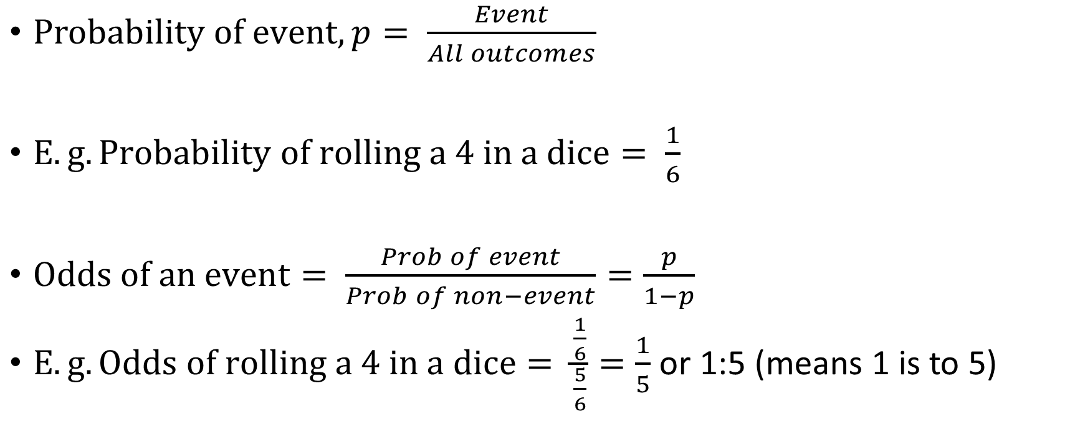
Refresher on Probability
$Probability of event,p= \frac{Event}{All outcomes}$
$E.g. Probability of rolling a 4 in a dice= \frac{1}{6}$
$Odds of an event= \frac{Prob of event}{Prob of non−event}=\frac{p}{1−p}$
$E.g. Odds of rolling a 4 in a dice= \frac{\frac{1}{6}}{\frac{5}{6}}=\frac{1}{5}$ or 1:5 (means 1 is to 5)

Slide 11
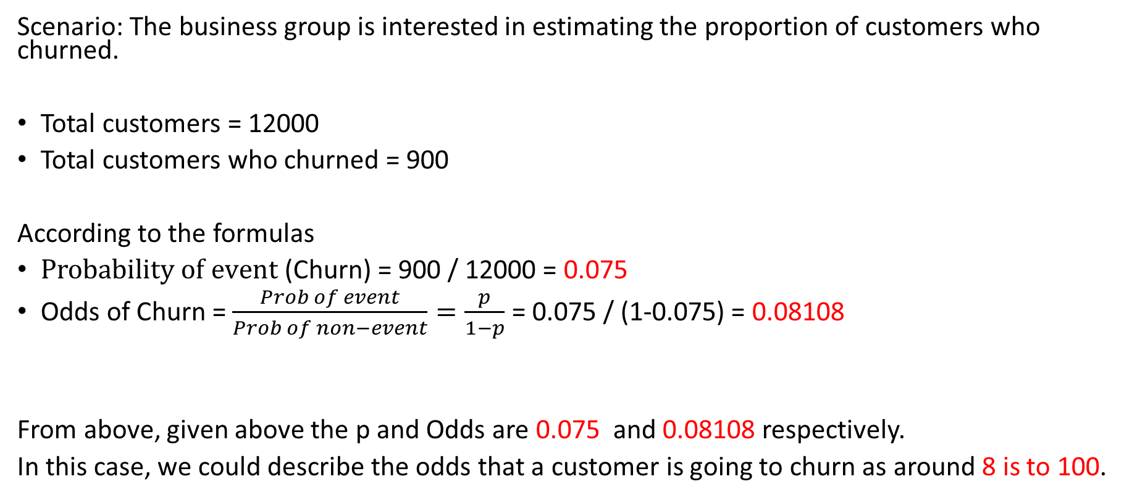
Let us look at the working example for Odds Ratio
Scenario: The business group is interested in estimating the proportion of customers who churned.
Total customers = 12000
Total customers who churned = 900
According to the formulas
$Probability of event$ (Churn) = 900 / 12000 = 0.075
Odds of Churn = $\frac{Prob of event}{Prob of non−event}=\frac{p}{1−p}$ = 0.075 / (1-0.075) = 0.08108
From above, given above the p and Odds are 0.075 and 0.08108 respectively.
In this case, we could describe the odds that a customer is going to churn as around 8 is to 100.

Slide 12
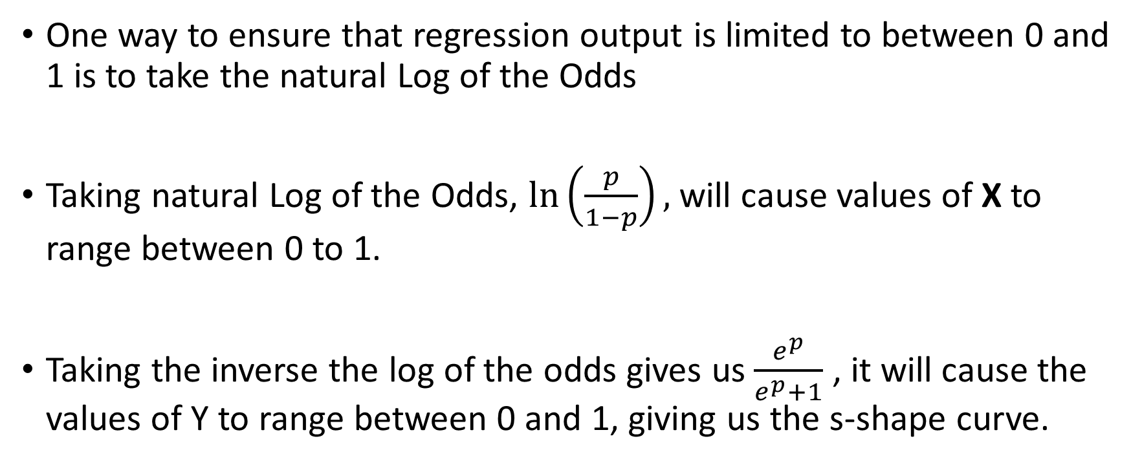
Getting the Curve
One way to ensure that regression output is limited to between 0 and 1 is to take the natural Log of the Odds
Taking natural Log of the Odds, $\ln\left(\frac{p}{1−p}\right),$ will cause values of X to range between 0 to 1.
Taking the inverse the log of the odds gives us $\frac{e^{p}}{e^{p}+1}$ , it will cause the values of Y to range between 0 and 1, giving us the s-shape curve.

Slide 13
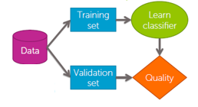
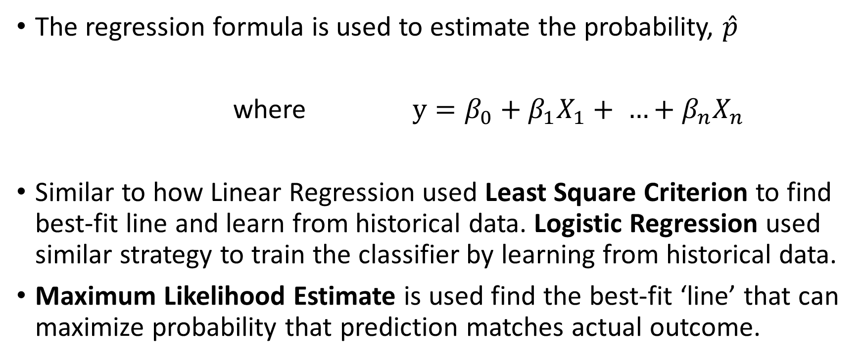

Where does y = mx + c come in?
The regression formula is used to estimate the probability, $\hat{p}$
where $y=β_{0}+β_{1}X_{1}+ …+β_{n}X_{n}$
Similar to how Linear Regression used Least Square Criterion to find best-fit line and learn from historical data. Logistic Regression used similar strategy to train the classifier by learning from historical data.
Maximum Likelihood Estimate is used find the best-fit ‘line’ that can maximize probability that prediction matches actual outcome.
$$\hat{p}= \frac{e^{y}}{e^{y}+1}$$

Slide 14
Logistic Regression
Result is a Sigmoidal curve

Slide 15
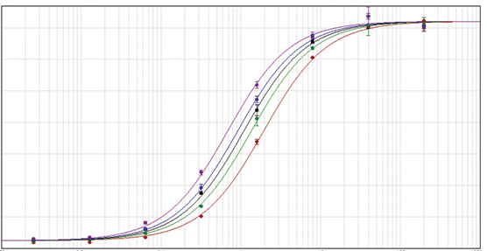
Learning in Logistic Regression
Maximum Likelihood Estimation will find the best curve to capture the target value in historical data

Slide 16
Restriction on inputs (encoding on categorical inputs)
Like Linear Regression, Logistic Regression expects inputs to be numeric.
How can we prepare categorical inputs for Logistic Regression?
Gender |  | Gender
Male |  | 0
Female |  | 1
Response |  | Response
Yes |  | 0
No |  | 1
Maybe |  | 2
Payment Method |  | Payment Method – Cash | Payment Method – Credit
Cash |  | 1 | 0
Credit Card |  | 0 | 1
E. Transfer |  | 0 | 0
Strategy 1: Re-code into numbers.
Strategy 2: Create ‘dummy’ fields

Slide 17
How do we evaluate model accuracy?
 | Predicted ‘Yes’ | Predicted ‘No’
Actual ‘Yes’ | TP (True Positive) | FN (False Negative)
Actual ‘No’ | FP (False Positive) | TN (True Negative)
Confusion Matrix
Notes:
This table shown here is commonly referred to as the coincidence matrix or the confusion matrix.

Slide 18
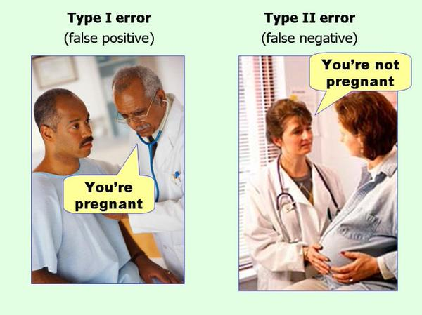
FPs and FNs
https://chemicalstatistician.wordpress.com/2014/05/12/applied-statistics-lesson-of-the-day-type-i-error-false-positive-and-type-2-error-false-negative/comment-page-1/

Slide 19
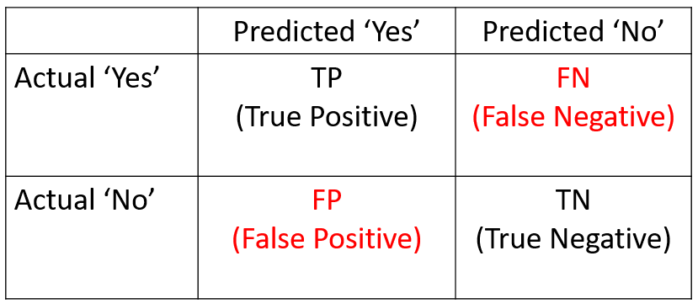
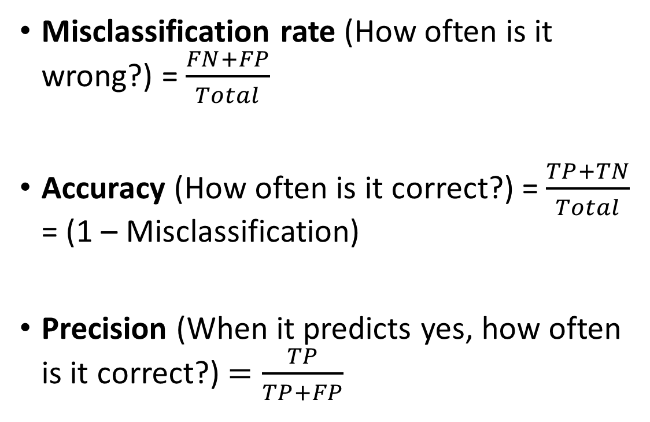
How do we evaluate model accuracy?
Misclassification rate (How often is it wrong?) = $\frac{FN+FP}{Total}$
Accuracy (How often is it correct?) = $\frac{TP+TN}{Total}$ = (1 – Misclassification)
Precision (When it predicts yes, how often is it correct?) $=\frac{TP}{TP+FP}$
Others, e.g.:
Recall / Sensitivity,
False Positive rate,
Area Under Curve
Notes:
https://www.dataschool.io/simple-guide-to-confusion-matrix-terminology/

Slide 20

Summary
Logistic regression is used for classification task
It uses log odds to determine probability that input belongs to target class
Similar to linear regression, it finds a best-fit ‘line’, it uses Maximum Likelihood Estimate
Categorical data needs to be prepared when used
Coincidence matrix shows results of classification
Various metrics exists for measuring accuracy of
classification

Slide 21
Let’s test our understanding

Slide 22

Q: Linear Regression is not suitable for scenario where target is binary value (e.g. 0, 1)
True
False

Slide 23
Q: Logistic Regression does not use the Y = mx + c formula
True
False

Slide 24
Q: Categorical inputs needs to be prepared first before we can use them for Logistic Regression
True
False

Slide 25
Q: Logistic Regression use the Least Square Criterion to find the best fit line
True
False

Slide 26
Takeaway
Linear Regression and Logistic Regression are similar in many ways.
Both works only with numeric inputs and target. (We can transform categorical inputs to numeric)
Both make use of the y = mx + c formula to learn from historical data.
Logistic Regression use a function to transform the predicted outcome to be between 0 and 1.
Logistic Regression uses Maximum Likelihood Estimation to find the best S-shape curve

